Slide 1
Searching and Sorting
Chapter 9

Slide 2

9.1
Sorting Arrays

Slide 3
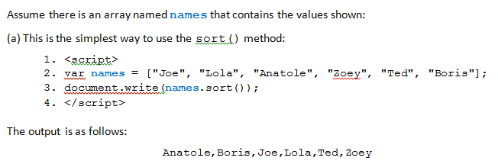
Sorting Arrays: the sort() method
Often we must search a one-dimensional array to locate a given item
or we must sort it in a specific order
There are many algorithms available to perform each of these tasks
Sometimes called routines
The sort() method:
The sort() method is called by using dot notation to append it to an array name
Syntax: array_name.sort()

Slide 4
Sorting Numbers with the sort() Method
Problem: The method compares the ASCII values of the numbers rather than their numeric values.
If 23, 5, and 17 were sorted using the sort() method, the result would be 17, 23, 5.
need to add a function that will compare numbers, not ASCII values.
function sortNumber(x,y) {
return x - y; }
use this function to sort an array of numbers by calling it when you call the sort() function:
array_name.sort(sortNumber);

Slide 5
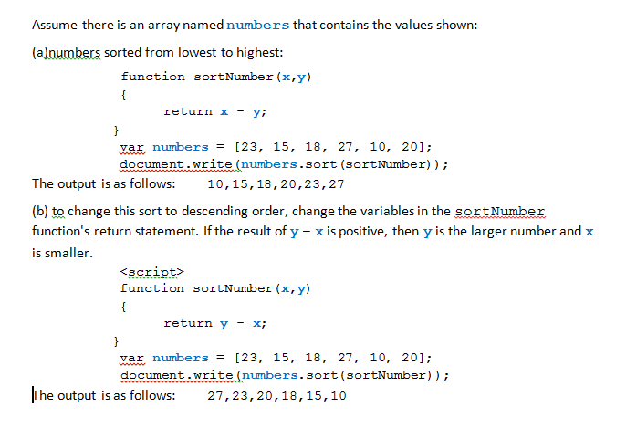

Slide 6
The Reverse()Method
The reverse() method reverses the order of elements in a given array.
The syntax is as follows:
array_name.reverse()

Slide 7
9.2
The Bubble Sort

Slide 8
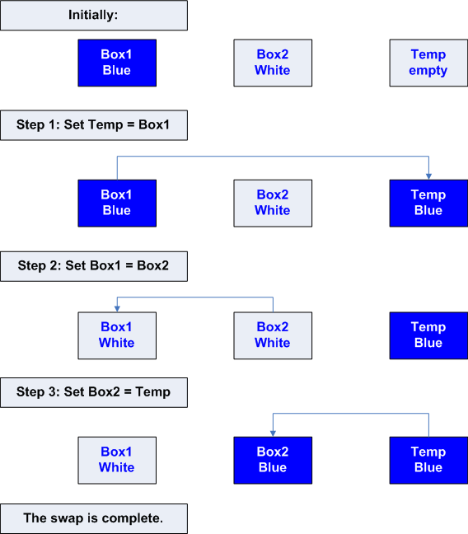
Swapping Values You must have a temporary holding place!

Slide 9
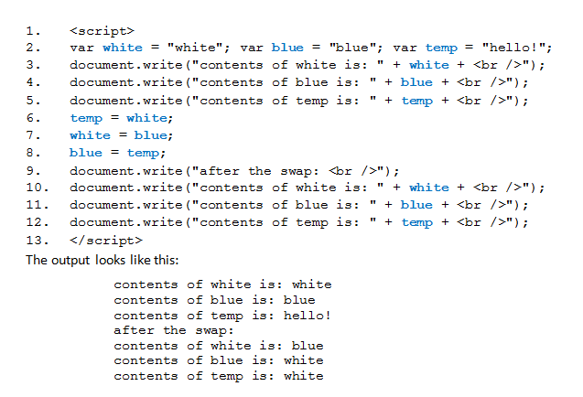
Using the Swap Routine to Exchange Values

Slide 10
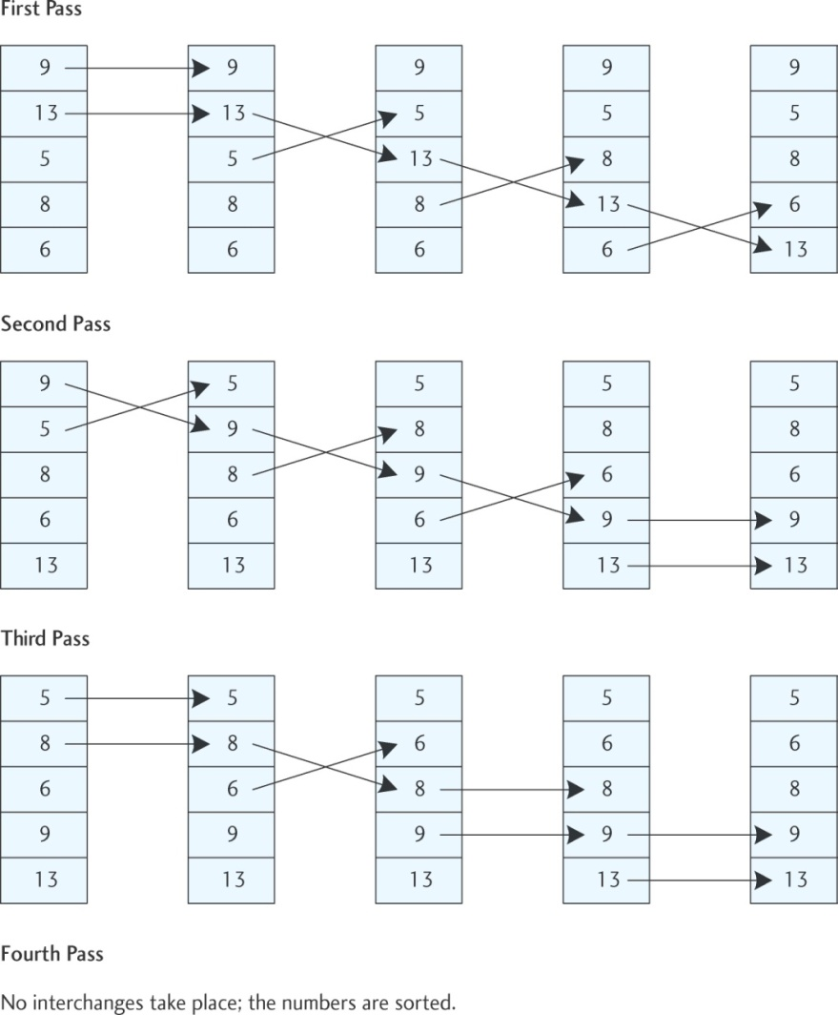
The Bubble Sort Algorithm
Given: var ages = new Array(9, 13, 5, 8, 6);
Bubble sort will do:

Slide 11
The bubble sort is used to sort of an array of N numbers
requires nested loops.
inner loop compares each element in the array to each of the other elements
at end of all iterations in the inner loop on the first time the outer loop executes, the largest number has sunk to the bottom
when inner loop has ended after the outer loop executes a second time, the 2nd-largest number has sunk to the next-to-last space.
The bubble sort fills the array with correct elements from last to first.
The outer loop must execute N – 1 times, where N is the number of elements in the array.
General pseudocode to sort ascending:
while (the array items is not sorted)
{
for (K = 0; K < N; K++)
{
if (items[K] > items[K + 1])
{
interchange items[K] and items[K + 1]
}
}
}

Slide 12
Passing Arrays
When arrays are passed to a function, since they are JavaScript objects, they are passed by reference.
Can use this to pass arrays into .js file functions
Good to include, in a source file library, such functions as:
Populating an array
Sorting ascending
Sorting descending

Slide 13
9.3
The Selection Sort

Slide 14
Selection Sort
a more efficient way to sort data stored in an array than the bubble sort
Basic idea: Make several passes through the array:
On first pass locate the smallest array element and swap it with the first array element.
On second pass locate the second smallest element and swap it with the second element of the array.
On third pass locate the next smallest element and swap it with the third element of the array.
And so forth . . .
If the array contains N elements, it will be completely sorted after at most N – 1 passes.

Slide 15
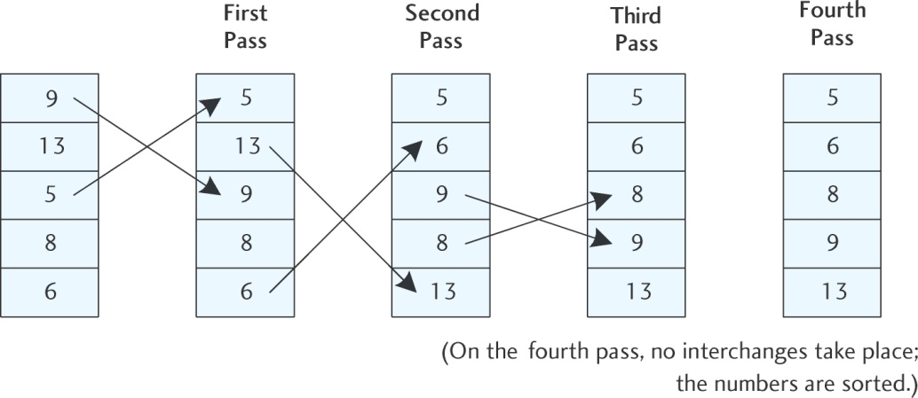
Selection sort of 9, 13, 5, 8, 6

Slide 16
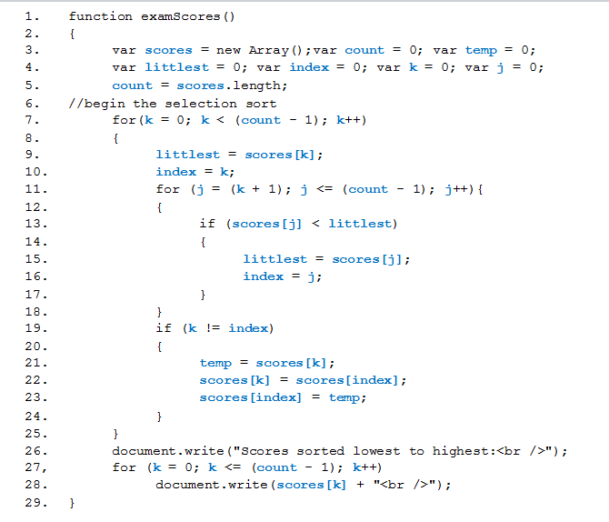
For this program, assume the scores array has been populated with many values.

Slide 17
9.4
Searching Array: the Serial Search

Slide 18
The Serial Search
Simple concept
elements in a given array are compared, one by one, to the search key (the value that is searched for).
only two possible results after a search is complete; either the value is found in the array or it is not.
if the array being searched is large enough, it may be inefficient to check each element when the search might end (the value may be found) at the beginning of the array
a flag is used to identify when the search has been successful and to exit the search at that time.

Slide 19
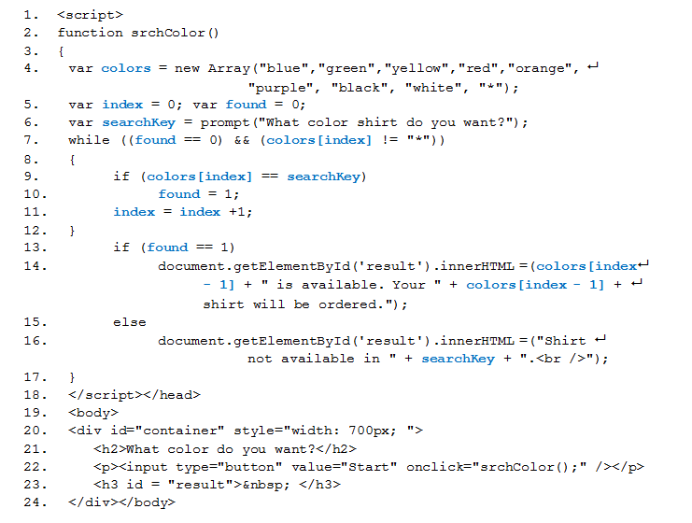

Slide 20
9.5
Searching Arrays: the Binary Search

Slide 21
The Binary Search
The binary search: a good way to search a large amount of data for a particular item
The item is called the search key
more efficient than the serial search technique
requires that the array of data to be searched is in numerical or alphabetical order
Imagine you want to look up a certain word (the target word) in a dictionary:
Using a serial search would require you to start on the first page and go through the dictionary word by word
better to open the dictionary in the middle and check the target word against an entry on that page
if you have gone too far you can ignore the second half of the dictionary
If you have not gone far enough you can ignore the first half of the dictionary
repeat these steps using the middle of the half you are interested in until you have located the target word

Slide 22
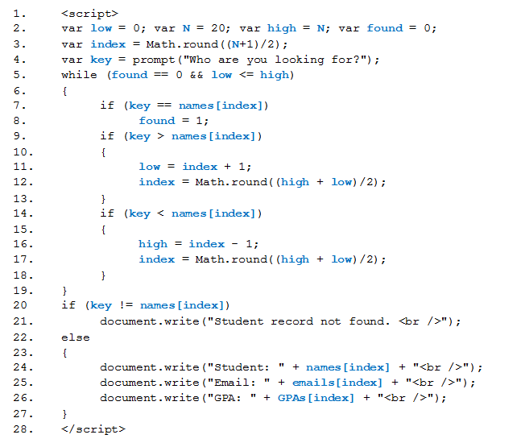

Slide 23
The indexOf() Method
The indexOf() method searches an array for a specified item and returns the item's position in the array.
The syntax to use this method is as follows:
var veggies = new Array("lettuce", "carrots",
"celery", "peppers");
var bestVeggie = veggies.indexOf("celery");
Result: bestVeggie = 2 because "celery" is veggies[2].
If search item is not found, the return value is -1.
The indexOf() method also allows you to search an array from any place you want to start.
The default starting position is 0
The general syntax:
arrayName.indexOf(search_item, start_position)

Slide 24
The lastIndexOf() Method
The indexOf() method searches an array for a specified item and returns the item's position in the array
The lastIndexOf() method also allows you to search an array from any place you want to start
The default starting position is the last element in the array
The general syntax:
arrayName.lastIndexOf(search_item, start_position)

Slide 25
Timers: the setInterval() and clearInterval() functions
The setInterval() method executes a function once for every given time interval.
The syntax of this function is as follows:
setInterval(function_name, milliseconds);
You can stop executions of the function specified in the setInterval() function by using the clearInterval() method.
This function takes one argument, a variable, which is returned from setInterval().

Slide 26
